Slide 1
Transmission media presented by: monira akter is-02 id: is -02-13

Slide 2
Contents:
What is Transmission Media?
Transmission media
Unguided media.
Guided Media.
Which One is Better?

Slide 3
What is a transmission media?
A physical path
Through which data is transmitted.
One device to another.

Slide 4
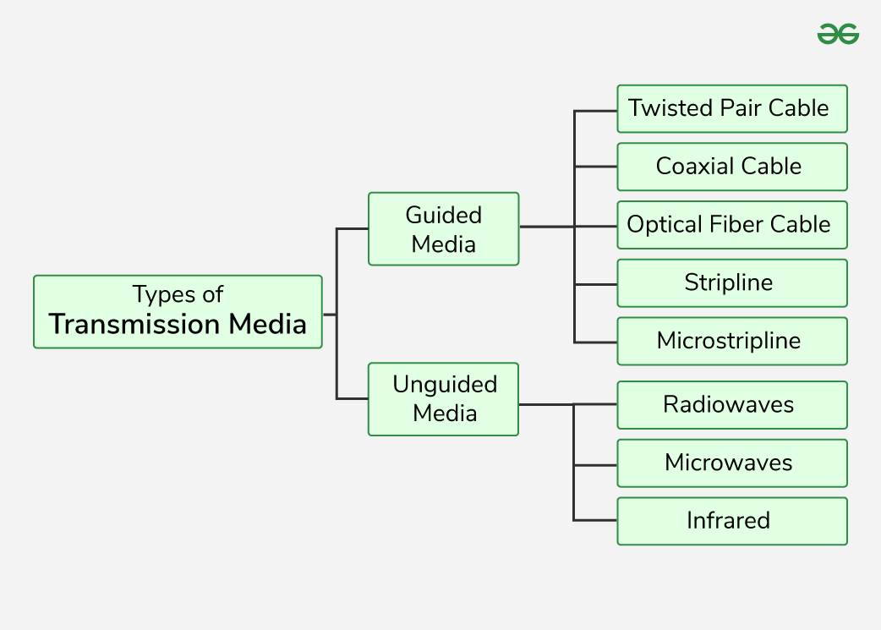
Media transmission paths:
1.Guided Media.
2.Unguided Media.

Slide 5
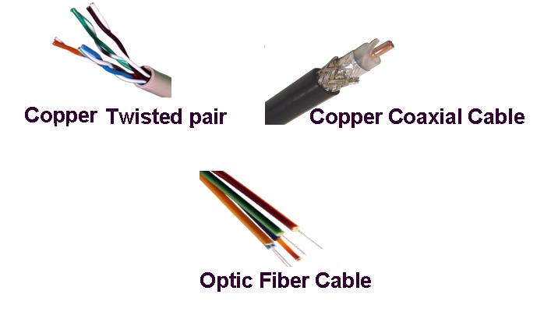
Guided media
Coaxial Cable
Fiber Optic Cable
Twisted Pair Cable

Slide 6
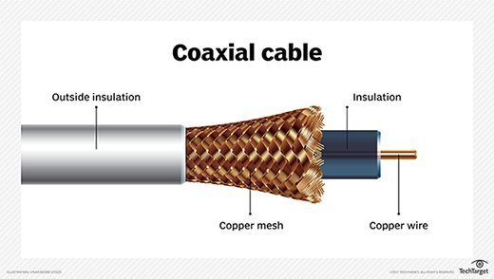
Coaxial Cable:
Has a central conductor.
Has a braided shield.
An outer jacket is there.

Slide 7
Uses of coaxial cable:
Cable television signals.
High speed computer data business.
Telephone trunk lines.
Broadband internet networking cables.
Connecting radio transmitters and receivers to their antennas.

Slide 8
Limitations of coaxial cable:
Costly.
Not safe (can be tapped easily).
Limited distance.
Limited bandwidth(80 mbps/second).
Large in size. Difficult to install.
Can be damaged easily.

Slide 9
Advantages of coaxial cable:
High bandwidth for TV an Internet connections.
Efficient transmission allows less transmission loss.
Resistance to interference.
Comparatively affordable than Fiber Optic cables.

Slide 10
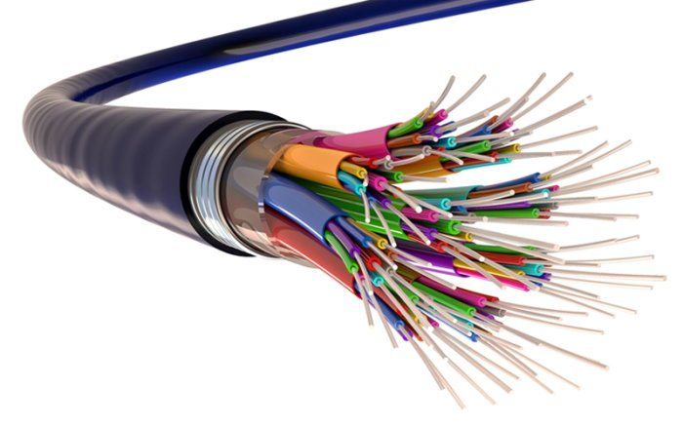
Fiber Optic Cable:
Uses light pulse
Consists of thin glass or plastic fiber.

Slide 11
Uses of fiber optic cable:
Long distance communication.
Internet.
Telephone networks
Cable television.
Create LANs and WANs.

Slide 12
Limitations of fiber optic cable:
Installation Cost.
Fragility.
Specialized equipment.
Natural influences create data loss.

Slide 13
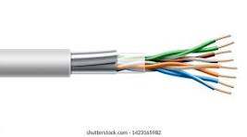
Twisted pair cable:

Slide 14
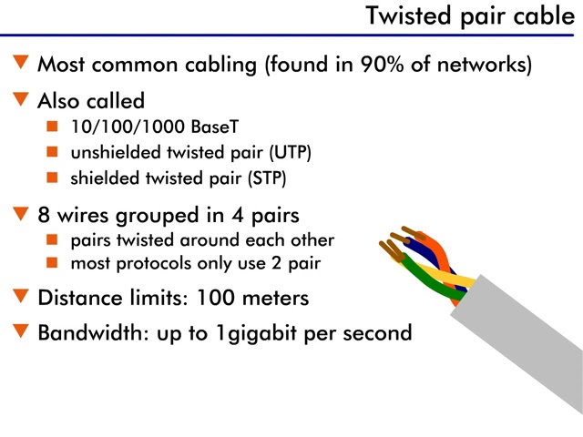
Uses of twisted pair cable:

Slide 15
Limitations of twisted pair :
EMI rate is comparatively disturbing.
Limited transmission distance.
Limited bandwidth.
Security.
Deformation process.

Slide 16
Advantages of twisted pair:
Prevents signal degradation.
Reduces crosstalk.
Sustains higher frequencies.
Uses smaller diameter.

Slide 17
Any query?

Slide 18

Thank you

